Slide 1
Breeds: Tips and Tricks

Slide 2
Beef Cattle

Slide 3
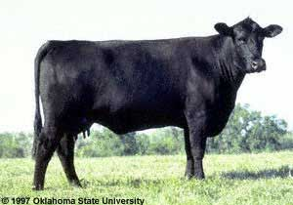
Angus
Black
Very well muscled
Polled
Smooth rectangular body
Red color does exist

Slide 4
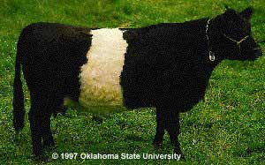
Belted Galloway
Has a distinct white belt!
Thick curly hair
No horns

Slide 5
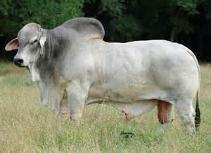
Brahman
Has a large hump over the
top of shoulder
Their ears are usually long and
Pendulous
They have an excess amount skin
In throat and dewlap
Grey
Slanted rump
From USA

Slide 6
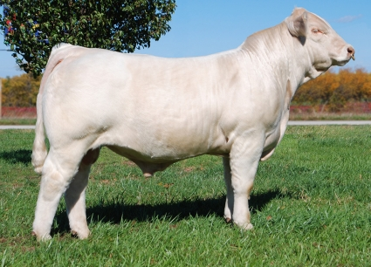
Charolais
Long bodied
White to straw colored
Pink nose

Slide 7
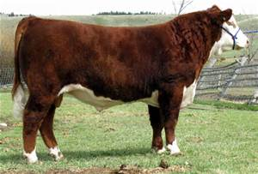
Hereford
White faced with colored body
Polled or horned
Gentle breed

Slide 8
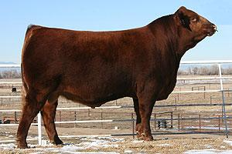
Limousin
More compact than the Shorthorn
Shorter bodied
Red with tan under/legs

Slide 9
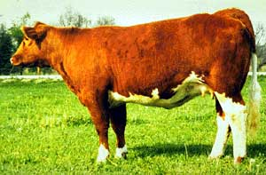
Maine-Anjou
Large breed in France
Weighing 2200-3100 lbs
Coloring is very dark
with white markings
on head, belly, rear
legs and tail

Slide 10
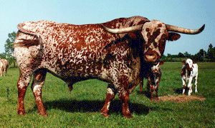
Texas Longhorn
Look at the horns!
Breed was developed
in North America
(fun fact)
High shoulders
Spotting

Slide 11
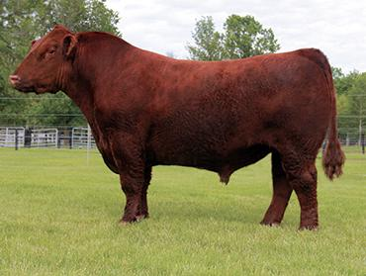
Shorthorn
Full red body
Can be Red, white, or roan
Very well muscled
More pronounced over the neck compared to the Limousin

Slide 12
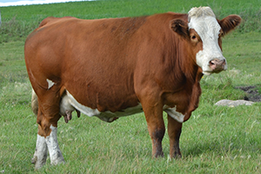
Simmental
White markings on head and feet
Lighter in red color compared to the Hereford
Ears set low
Hanging dewlap
Large breed

Slide 13
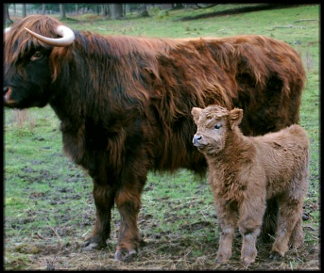
Scottish Highland
The small fuzzy breed of the bunch
Long lashes and forelocks (mop top)
Reddish in color

Slide 14
Dairy Breeds

Slide 15
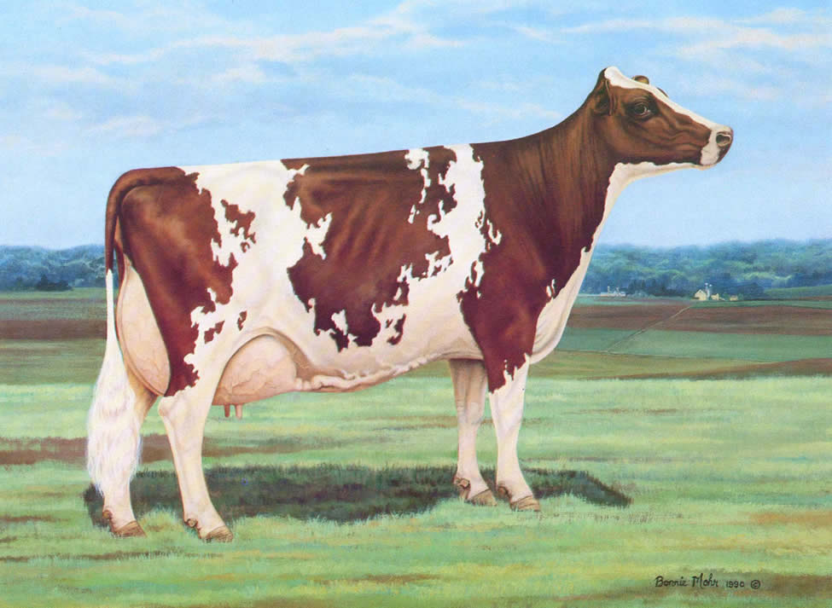
Ayrshire
Red and White
More “dairy” compared to Holstein especially through neck and legs
Small jagged spots
~1200 lb mature weight

Slide 16
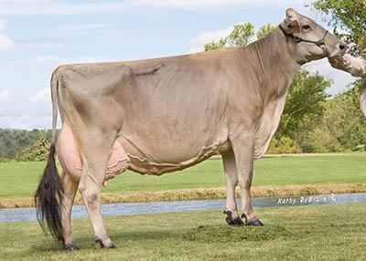
Brown Swiss
Brown in color but much larger then Jersey
~1450 lb mature weight
Slow growth, docile

Slide 17
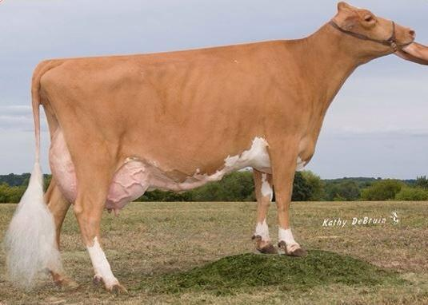
Guernsey
Fawn and white color
Milk is a golden yellow color
Fast grower
~1100 lb mature weight

Slide 18
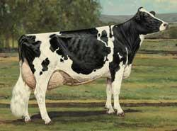
Holstein
Black and White give away
Large
  ~1500 lb mature weight
Huge udders
Wedge shaped body built for milking

Slide 19
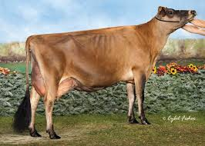
Jersey
Smallest dairy breed
  ~1000 lb mature weight
Can have black markings over head and legs

Slide 20
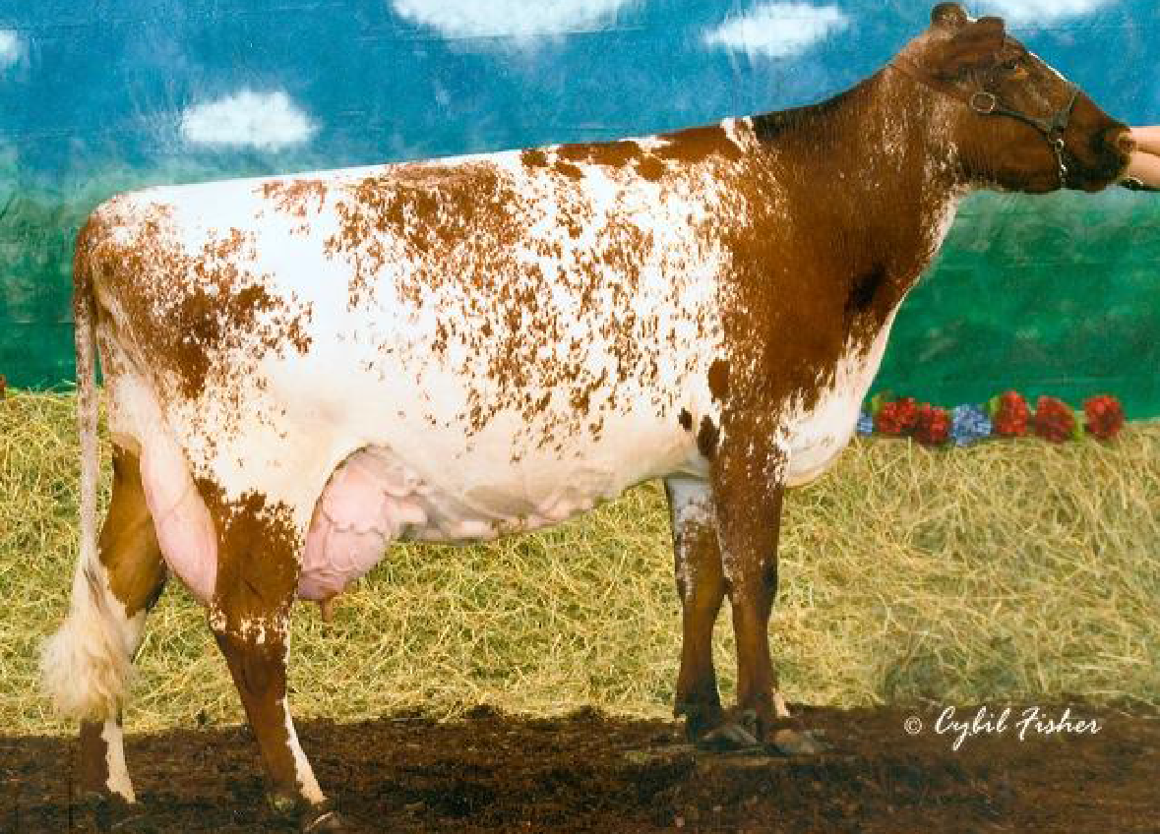
Milking shorthorn
Roan colored (red and white flecks)
Straight face
More beef qualities
since dual
purpose

Slide 21
Cat Breeds

Slide 22
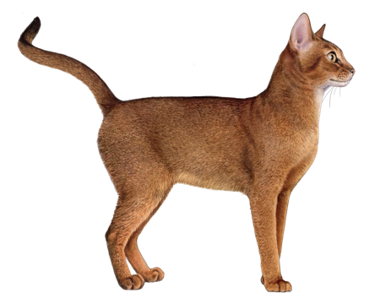
Abyssinian
Large ears
Ruddy ticked coat

Slide 23
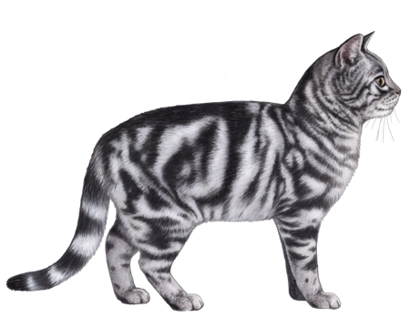
American Shorthair
Typical house cat
Short fur
Can be any color this one is white and grey

Slide 24
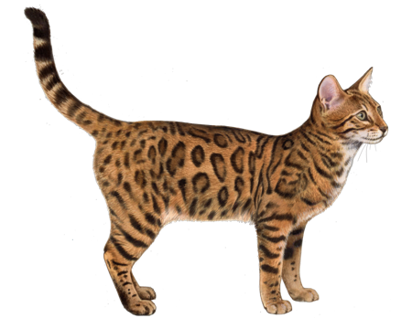
Bengal
Rosette spots like a leopard
Wide nose
Thick tail
Plush coat

Slide 25
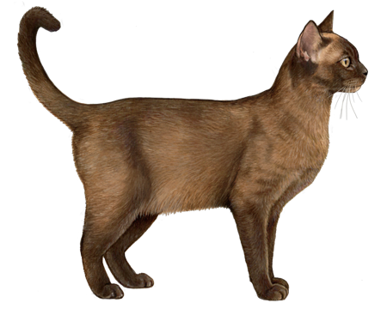
Burmese
Large eyes either yellow or golden
Satiny fur
Compact body with rounded head

Slide 26
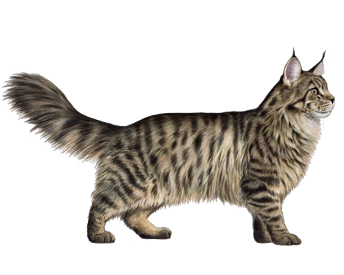
Maine Coon
Large breed cat
Smooth shaggy fur
Large, well-tufted ears are wide at the base, tapering to a point
large, expressive eyes are green, gold, greenish-gold or copper.

Slide 27
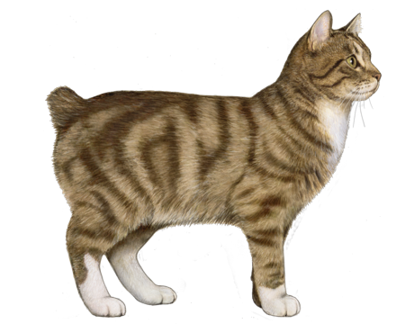
Manx
Tailless!

Slide 28
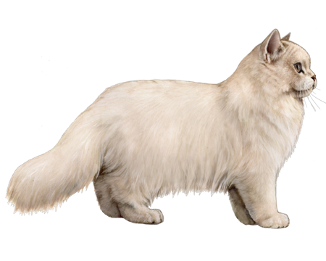
Persian
a large, round head; large, round eyes; a short nose
full cheeks; and small ears with rounded tips

Slide 29
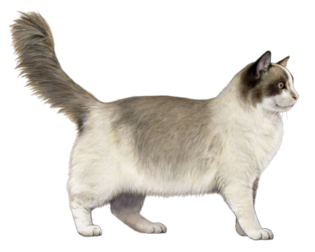
Ragdoll
-Plush, fluffy semi-long hair coat
-various colors but characteristic “pointed” pattern
-true purebred will always have blue eyes

Slide 30
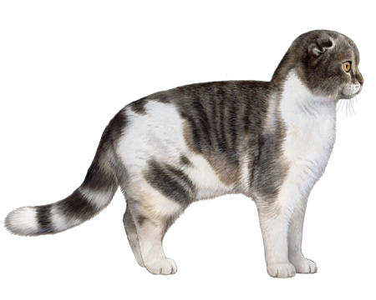
Scottish Fold
Named for the folded ears

Slide 31
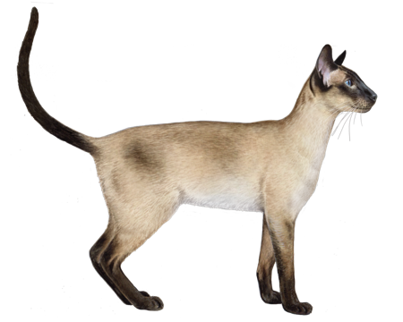
Siamese
a large, round head; large, round eyes; a short nose; full cheeks
Unusually large ear bases that round at the tips.
Blue eyes
Tubular body

Slide 32
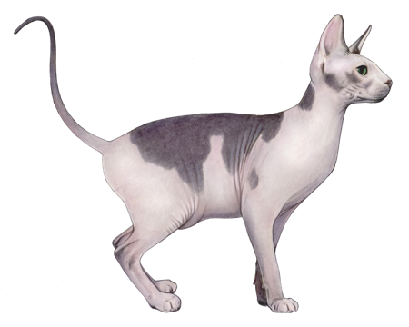
Sphynx
Hairless (mostly)

Slide 33
Dog Breeds

Slide 34
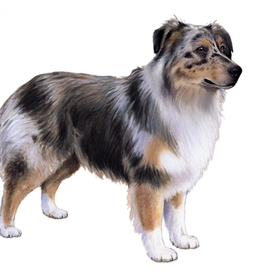
Australian Shephard
-well muscled and athletic appearance
-distinguished tri-color coat
-bobbed tail

Slide 35
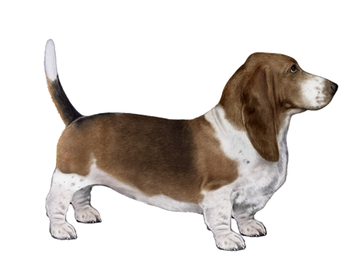
Bassett Hound
Very short-legged
Long pendulous ears
Similar markings to the beagle but watch the leg length!

Slide 36
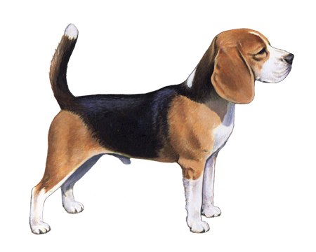
Beagle
Brown and Black with white markings
Tail flags when hunting

Slide 37
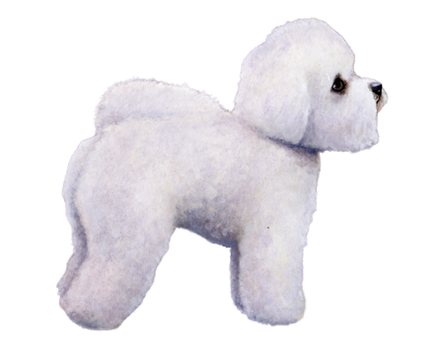
Bichon Frise
-Small, white,
-small tight curly hair
-Differentiate from the poodle

Slide 38
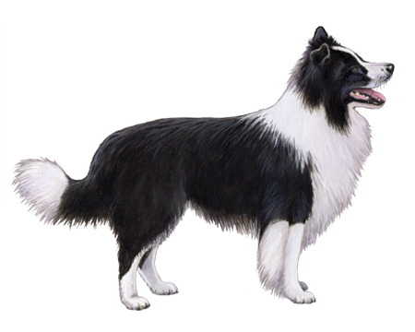
Border Collie
Long-haired
Curious and inquisitive face and ears

Slide 39
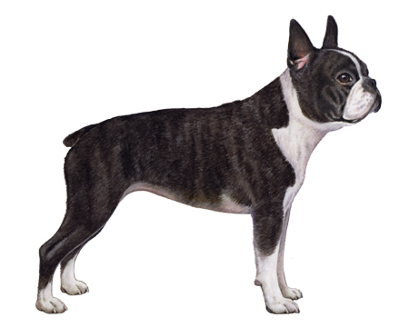
Boston Terrier
-short, flat face
-black and white markings
-compact, square body

Slide 40
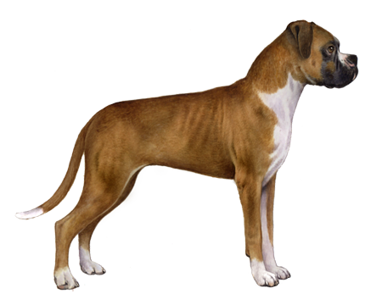
Boxer
Short muzzle and box-like head
Deep and wide chested
Short tail and very pointed ears

Slide 41
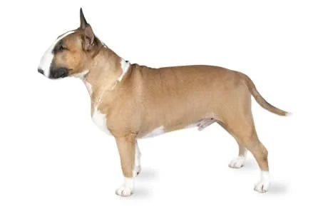
Bull Terrier
-broad large head
-muscular, big-boned physique

Slide 42
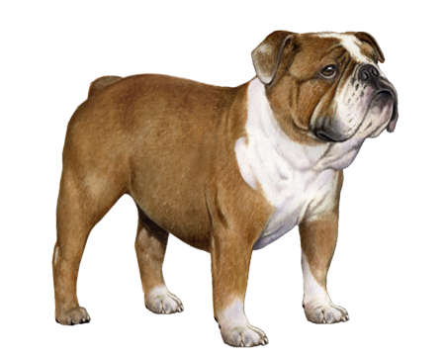
Bulldog
Big jowls and facial folds
Short ears
Wide muscular chest

Slide 43
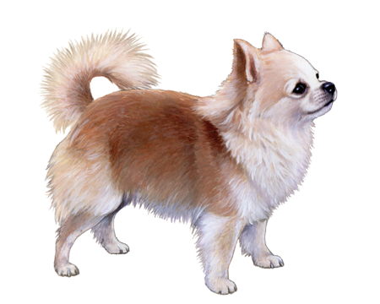
Chihuahua
“Taco Bell” dog
Very small body
Short nose and big ears for its head

Slide 44
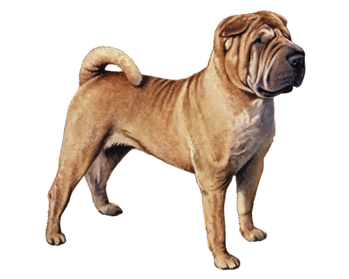
Chinese Shar-Pei
Lots of rolls over face and body
Can hardly see ears

Slide 45
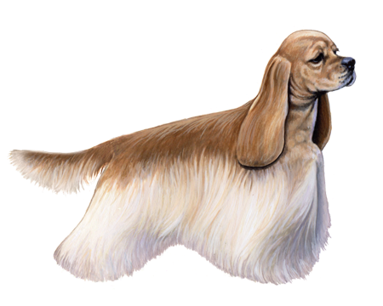
Cocker Spaniel
Lots of hair “feathers”
Long ears
Short tail

Slide 46
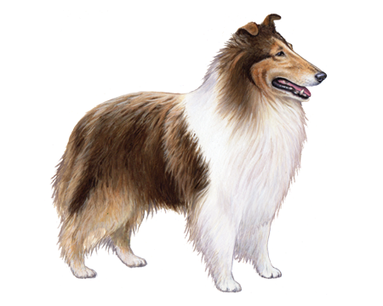
Collie
Long narrow muzzle
Very fluffy long fur

Slide 47
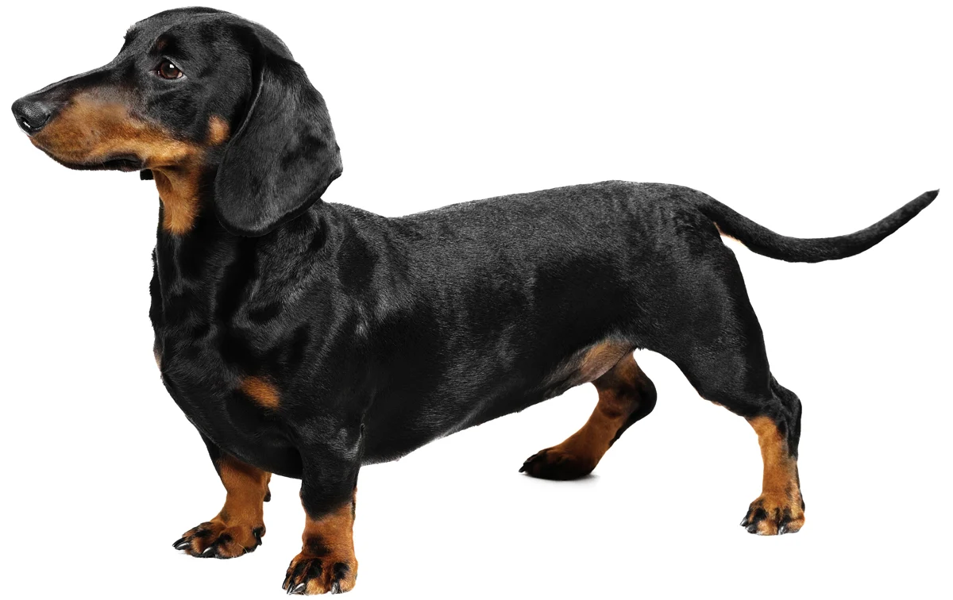
Dacshund
Short legged
Long back
Narrow long tail

Slide 48
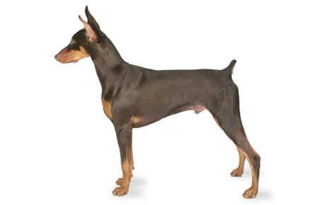
Doberman Pinscher
Mostly black with brown markings
Very short docked tail
Tall pointed ears if cropped

Slide 49
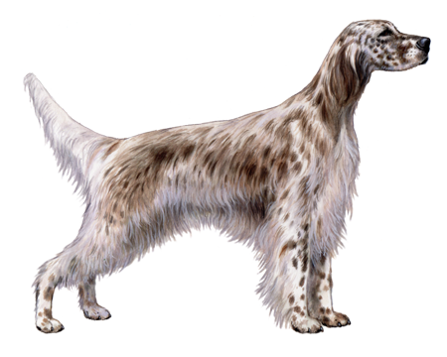
English Setter
White with liver spots
Long fur on underbelly, chest and tail

Slide 50
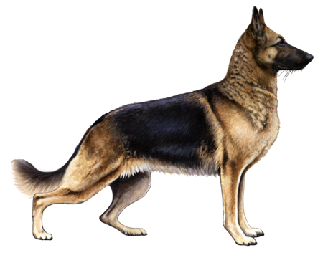
German Shepard Dog
Long sloped back with hips closer to ground
Tall pointed ears
Long fluffy tail

Slide 51
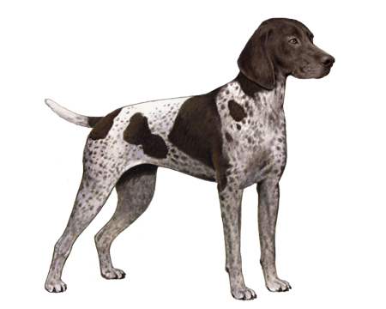
German Shorthaired Pointer
Very short-haired
White with liver spots and markings
Short docked tail

Slide 52
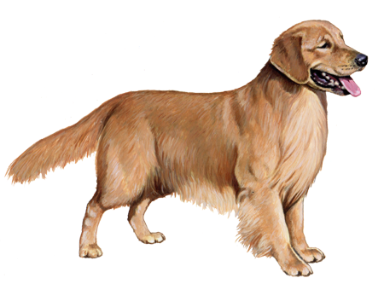
Golden Retriever
Golden color
Feathers on legs
Fluffy tail

Slide 53
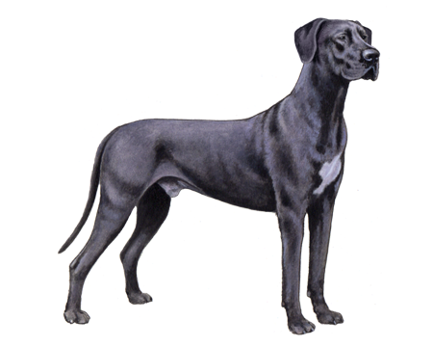
Great Dane
Tall!
Tail hard to see, usually tucked up under them
Fawn, black, blue, and Harlequin colored

Slide 54
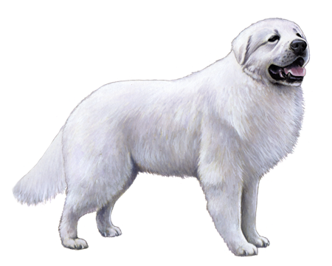
Great Pyrenees
Giant white fluff ball!

Slide 55
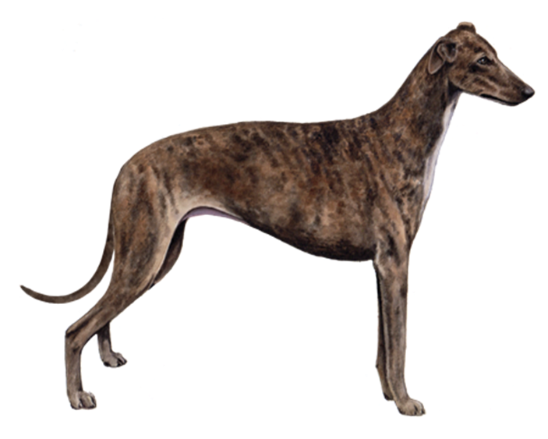
Greyhound
Very petite and lean
Tail tucked

Slide 56

Labrador Retriever
Solid color
Muscled dog

Slide 57

Maltese
Long fur covers legs (when groomed)
Small petite face
Mostly white with some dark accents

Slide 58

Miniature Schnauzer
Has a beard
Grey and white
Long square shaped muzzle
Short pointed ears
Short tail.

Slide 59

Pembroke Welsh Corgi
Another short dog
Longer hair coat than Bassett and bigger than Dachshund
Looks like a short Shepard
Short/no tail, fluffy gluteals!

Slide 60

Pomeranian
Small bear appearance
Very fluffy “mane”
Curled over back tail
Tan in color

Slide 61

Poodle
Tall breed dog
When groomed will have the poodle puff tail and fluffy legs
Fluffy ears which is mostly fur

Slide 62

Pug
Smushed face with facial folds
Curled tail over back
Typically tan body with black face and ears (but other colors)

Slide 63

Rottweiler
Large breed well-muscled and big chest
Black body with brown facial and leg markings
Big block head

Slide 64

Saint Bernard
“Beethoven”
Giant breed
Typically white with brown and black markings
Large jowls
Drooped facial expression

Slide 65

Scottish Terrier
Shorter than Schnauzer
Pronounced eyebrows
prominent beard

Slide 66

Shih Tzu
The other breed that shows with long flowy fur that covers legs
Compared to Maltese has a smaller muzzle and more smush face appearance

Slide 67

Siberian Husky
Wolf-appearance
Has the grey and white double fur coat
Thicker ear base
Long muzzle

Slide 68

Yorkshire Terrier
Typically brown and black
Unlike Maltese and Shih Tzu tail is straight and generally smaller
Usually beard even when not show-ready

Slide 69
Horse Breeds

Slide 70

Appaloosa
Spots and dots are a breed characteristic!
Body type is usually well muscled
Thin tail and mane
Striped feet

Slide 71

Arabian
Dished face
Arched neck
High tail carriage
Short, straight back
Lean body and legs
High spirited

Slide 72

Belgian
Draft breed
Chestnut with flaxen mane and tail
Heavy, large frame
Short back and legs

Slide 73

Clydesdale
Heavy ‘feathers’ (long hair near hooves)
Dark body with white face and feet
Draft breed
The “Budweiser” horse

Slide 74

Haflinger
Palomino coloring
  Yellow body with white mane/tail
Tough and sure footed
Mountain pack pony

Slide 75

Miniature Horse
The American Mini is under 34” and can be any color or pattern
  Not a pony, but it is to look like a horse in minature

Slide 76

Morgan
Compact, powerful
Bay, brown, black or chestnut
Short head, strong shoulders
Fluffy mane and tail
Feet set far back in show stance

Slide 77

Donkey
White nose
Black cross across shoulders
Long upright ears
Shorter than a horse

Slide 78

Paint
White splashes on another color
Usually well muscled

Slide 79

Percheron
Black or grey
Draft breed
High, arched neck
Pretty head
Little feather on legs

Slide 80

Quarter Horse
Well muscled stock horse type
  Big hindquarters
  Short coupled body
  Fine legs
Short distance racing
Sturdy

Slide 81

Tennessee Walker
Solid colors
Common head
Tall crested neck
Sloping shoulder
Tail carried high (via fake means)
Fancy gaits
Big feet
Posed with legs parked out behind it

Slide 82

Thoroughbred
Bred for racing
Tall and rangy
Long leg, neck, and body
Fast and sensitive

Slide 83
Goat Breeds

Slide 84

Alpine
Any color
Horned or polled
Dairy goat build
No dewlap
From France

Slide 85

Angora
Used for wool/hair
  Avg 6-7# wool/year
White wool (AKA fleece)
White face/feet
Horned or polled
Long droopy ears
From Turkey

Slide 86

Boer
White body with red head and face
Horned
Meat goat
From South Africa
Prolific breeder – 3 sets of lambs every 2 years

Slide 87

LaMancha
Any color
Dairy goat
From USA
TINY ears!
  Gopher ear <1”
  Elf ear <2”

Slide 88

Nubian
Any color
Dairy goat
Roman nose
Droopy ears
No beard on does
From Africa

Slide 89

Oberhasli
Medium sized dairy breed
  Look at that udder!
Solid red or black colors

Slide 90

Pygmy
Any color
Horned
Meat and milk goat
Small head and legs
Bucks have long beards
From Cameroon

Slide 91

Saanen
Always white
Dairy goat
Larger breed
Very gentle breed

Slide 92

Toggenburg
Fawn/brown with 2 white stripes on face
Horned or polled
Dairy goat build
From Switzerland
Medium hair

Slide 93
Specialty Breeds/Pets

Slide 94

Bearded Dragon
Has a browish/yellow color
Long limbs and obvious toes with nails
Smaller flat head compared to Iguana

Slide 95

Chinchilla
Large ears relative to head
Long tail to balance
Short forelimbs
Large flat hindfeet
Thick greyish black fur

Slide 96

Cockatiel
Has the distinct orange cheeks
Long head plume feathers
More grey base color with accents of yellow, blue, etc.

Slide 97

Ferret
Long bodied rodents
Pointed nose
Small flatter ears

Slide 98

Gecko
Typically 7-10 inches in length
Can have bright colors or be multi-colored
Toes are suction cup like and circular

Slide 99

Gerbil
Small bodied with relatively large ears
Long furless tails
Larger hindfeet

Slide 100

Guinea Pig
Round tube like body with very short legs
Small ear flaps
Fur covered body

Slide 101

Hamster
No tail (very short)
  Biggest difference! If you can’t see tail it’s a hamster
Small bodied

Slide 102

Hedgehog
Small rounded body
Thick modified hairs all along back
Small pointed nose

Slide 103

Iguana
Green with accented greenish-blue on face
Long toes with nails
Had flap of skin under chin
Has spiky appearance along back
Grows several feet long

Slide 104

Macaw
Large social parrot
Large thick beak for cracking hard nuts compared to the other seed-eaters seen.

Slide 105

Parakeet
Green base color with black markings along back and yellow head (other colors exist)
Has blue over bridge of beak

Slide 106

Potbellied Pig
Smaller and more compact than commercial pigs
Shorter snout and face

Slide 107
Rabbit Breeds

Slide 108

Californian
Upright ears
Commercial type
Looks like Siamese cat
  White body, black ears/nose/feet
  Larger, 9#
  Pink eyes

Slide 109

Dutch
White band around chest and face blaze
  Back half is always colored
Black, blue, chocolate, grey, steel color
4.5 #
  Compact but not a dwarf breed
Erect ears

Slide 110

Angora
6#
Ears carried in a “v” shape
White and many colored
Round ball of fluff
  Wool!
Silky wool needs grooming

Slide 111

Flemish Giant
Largest breed! 14# and 20” long
More laid-back than smaller breeds
Erect ears with heavy ear base

Slide 112

Jersey Wooly
3# dwarf breed
Popular pet
  Wool coat
  Many colors
  Erect ears
  Compact body

Slide 113

Mini Lop
Solid or broken (white and colored) patterns
  Almost any color
Looks like a French lop but smaller at 6#
Lopped ears!
Chunky body
Often pets

Slide 114

Mini Rex
Many colors in solid and broken patterns
4#
Dense and upright fur feels plush to the touch
Erect ears
Sits half a basketball
  Very rounded
Lack extra protective fur
  on bottom of foot

Slide 115

Netherland Dwarf
Baby-like features
Smallest breed, <2#
Small erect ears and big eyes
  Ears under 2” long
Round head
Many colors

Slide 116

Satin
Soft shiny coat with sheen
  Translucent hair shaft with small diameter
10#
Many varieties
Erect ears
Satin coat

Slide 117

New Zealand
Black, red, or white colored
Erect ear with heavy ear base
10#
Popular lab, meat, pet rabbit
Thick hindquarters

Slide 118

Tan
Black, blue, chocolate, lilac colored
  Top is colored and underside is always orangey-tan
    Like a Doberman pinscher
Arched body
5#

Slide 119
Swine Breeds

Slide 120

Berkshire
Black with white on legs, snout, and tail
Erect ears

Slide 121

Chester White
White
Drooped ears

Slide 122

Duroc
Red to reddish brown color
Drooping ears
Terminal breed
Meat known for good flavor
From the USA

Slide 123

Hampshire
Black body with white belt at shoulders
Erect ears
Heavily muscled
Terminal breed

Slide 124

Hereford
-red-brown and white coloration
-similar to Hereford cattle
-more white than the Duroc

Slide 125

Landrace
White color
Large floppy ears
Little arch to back

Slide 126

Poland China
Black with white on legs, snout, and tail
Drooped ears compared to Berkshire
Longer body

Slide 127

Spotted
Black and white spots
Drooped ears

Slide 128

Yorkshire
White color
Erect ears
Maternal breed

Slide 129
Sheep Breeds

Slide 130

Cheviot
White
  Black nostrils and hooves
Medium wool
  No wool on head or legs
Small breed
Polled
From England

Slide 131

Columbia
One of larger breeds
Medium wool length

Slide 132

Dorset
White face/feet
White wool
From England
Horned or polled
Medium wool
Medium size

Slide 133

Hampshire
Black face/feet
White wool
Dark skin underneath
Wool on top of head
Medium wool
Popular breed
Polled
From England

Slide 134

Jacob
piebald—dark-colored with areas of white wool
it is often polycerate or multi-horned.
  Has very impressive horns!

Slide 135

Merino
White
Bucks have horns, does are polled
Plush, fine wool
From Spain

Slide 136

Montadale
White wool
White face/feet
Medium wool
  No wool on head or legs
Polled
From USA

Slide 137

Rambouillet
White face/feet
White wool
Blocky body/trim
Fine wool
Horned or polled
From France

Slide 138

Southdown
White
Very light brown face/feet
Polled
Medium wool
From England

Slide 139

Suffolk
White wool
Black face/feet
No wool on top of head
From England
Medium wool

